Slide 1
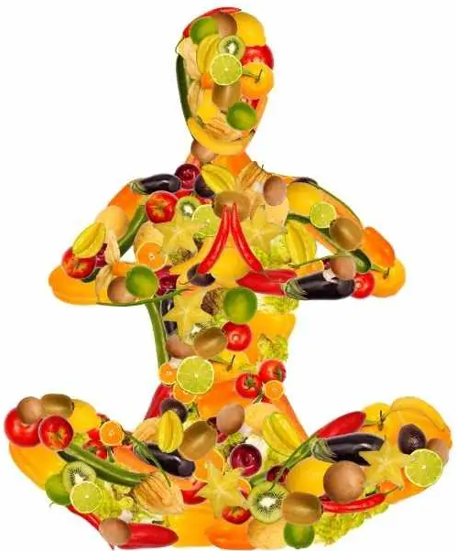
Unit 1: Basic concepts in food and nutrition
अन्न (food) हे (is) पूर्ण (Complete) ब्रह्म ( Universe i.e. Creation
Growth and Expansion
“We are what we eat.”

Slide 2
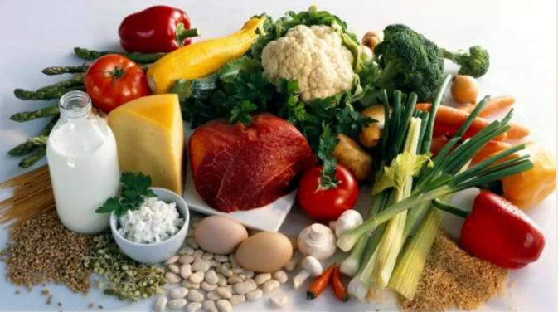
When we talk of Nutrition….we correlate it to Food

Slide 3
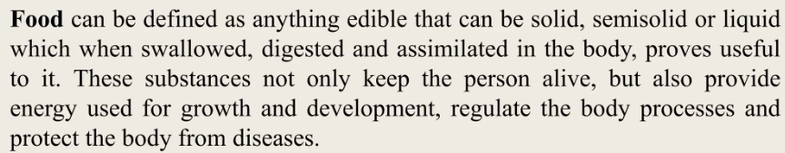
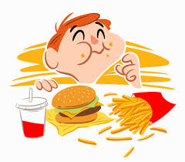
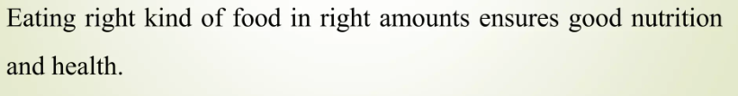
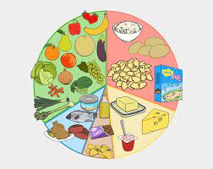

Hence, Nutrition is……….

Slide 4
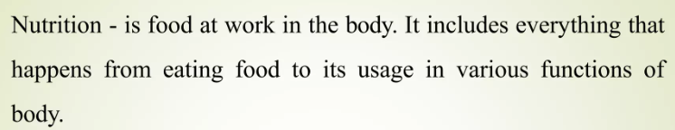
Nutrition is the science of the processes by which the body uses food for energy, maintenance, and growth OR
It is the study of nutrients in food, how the body uses them, and the relationship between diet, health, and disease
In broader sense

Slide 5
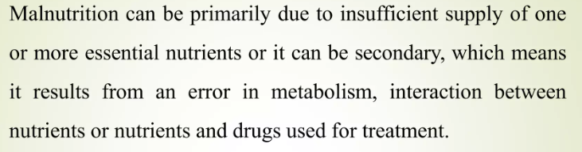
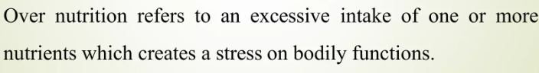
The World Health Organization (WHO) defines health as 'a state of complete physical, mental and social wellbeing and not merely the absence of disease or infirmity (physical or mental weakness)'.

Slide 6
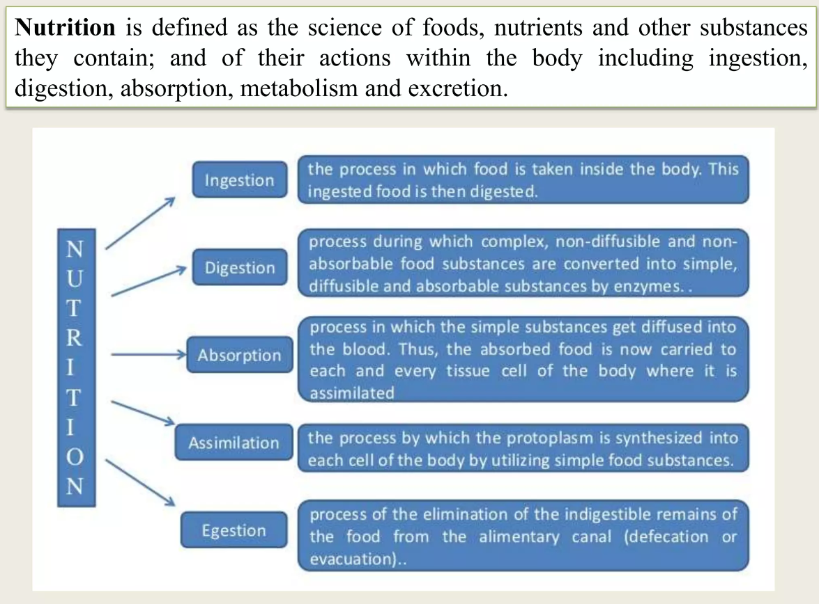

Slide 7
Holistic health is a system of preventive medicine that takes into account the whole individual. It promotes personal responsibility for well-being and acknowledges the total influences — biologic, psychologic, and social — that affect health, including nutrition, exercise, and emotional well-being.
Optimum nutrition, providing all nutrients in both kind and amount, is the cornerstone of good health.
The foods we eat, and the nutrients they provide, are the most important continuing factors influencing our growth, development, functional abilities, and health.

Slide 8
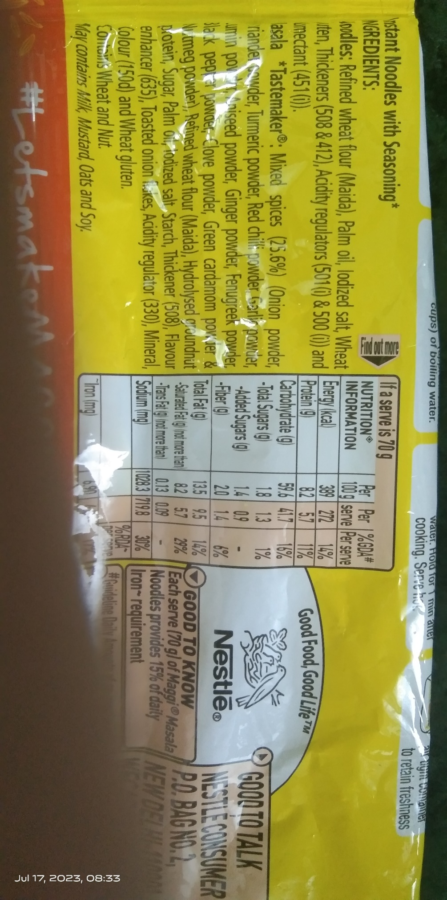
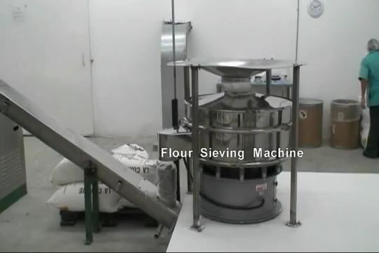
Presently, the society is overfed and paradoxically malnourished. Most processed foods come with a high content of simple sugars, saturated fat, and sodium leading to various diseases closely associated with the cardiovascular system, increasing the risk of suffering from them eg. Instant Noodles:
To understand the food we buy, we need to first
look at what goes into it.
Notes:
More…….@https://scroll.in/article/733440/one-thing-we-urgently-need-after-the-maggi-mess-a-better-understanding-of-food-labels

Slide 9

After having reviewed the fact, do we have answers to…………….
How important is our food?
Do we give attention and importance to the demands of our body and mental health?
Do we give attention and importance to our food?
What would we do to become more aware of the importance of what we eat at all times?
The bottom line is that you have the power to maintain and improve your health, and reduce your risk of disease.
And IT’S NEVER LATE TO MAKE A CHANGE. The solution…..
Nutrition is a tool that will take care of your health easily

Slide 10
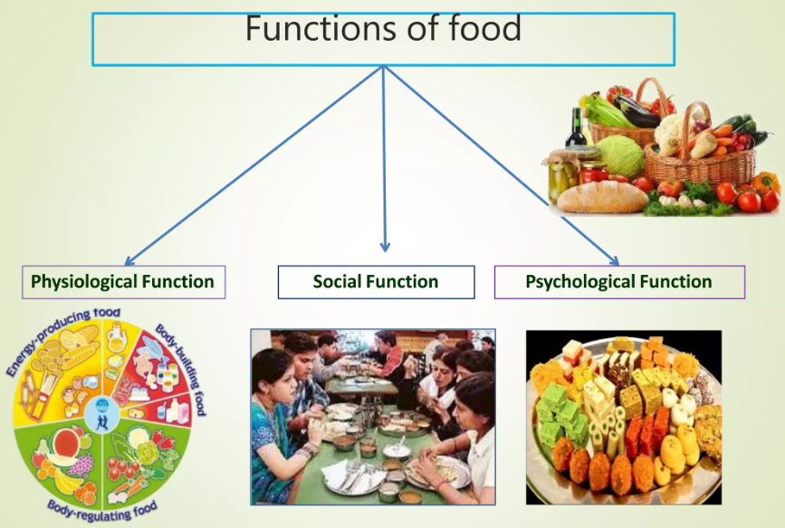


Slide 11
Physiological functions of food
Energy provision: The body needs energy to sustain the involuntary processes essential for continuance of life, to carry out professional, household and recreational activities, to convert food ingested into usable compounds in the body, to grow and to keep warm. This energy needed is supplied by the oxidation of the foods consumed
2. Building the body: A new-born baby weighing 2.7-3.2 kg can grow to its potential adult size of 55-60 kg if the right kind and amounts of food are eaten from birth to adulthood. The food eaten each day helps to maintain the structure of the adult body and to replace worn out cells of the body.

Slide 12
3. Regulation of bodily activities/Functions:
It includes regulation of varied activities such as:
Heart beat
Maintenance of the body temperature.
Control of water balance
Clotting of blood
Removal of waste products from the body
4. Immunity building: The fourth function of food is to improve our body’s resistance to disease or build up the immunity

Slide 13

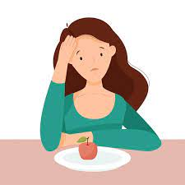
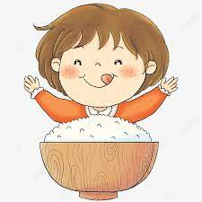
Psychological Function of Food
In addition to satisfying physical and social needs, food must satisfy certain emotional needs. You must have experienced that the food that you like gives you added pleasure.
Food is an expression of emotions
Emotions are expressed through food. A happy person eats more while an unhappy one eats less. Some people eat more to relieve their stress while some eat less.

Slide 14
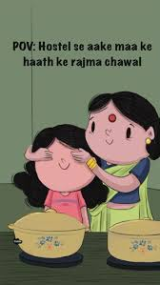
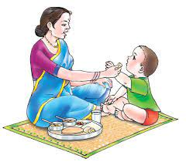
2. Food as a form of security:
Familiar foods make us feel secure. Anticipating needs and fulfilling these are expressions of love and attention. These sentiments are the basis of the normal attachment to the mother’s cooking.

Slide 15
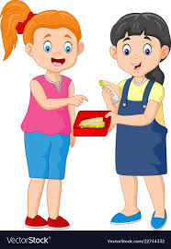
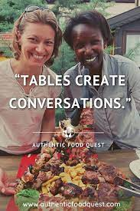
For instance: Sharing of food is a token of friendship and acceptance. In a friendly gathering we try unfamiliar foods and thus develop our food experiences. It must be noted that even a nutritionally balanced meal may not be satisfying to the individual, if the foods included are unfamiliar or distasteful to him/her. With time and repeated experience, strange foods become familiar and new tastes are formed. These aspects are important in food acceptance and must be considered in planning meals, which are not only nutritionally adequate, but also enjoyable for the group for whom they are intended.

Slide 16
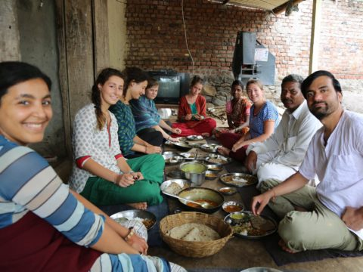
Social Function of Food
Food has always been the central part of our community, social, cultural and religious life. It has been an expression of love, friendship, and happiness at religious, social and family get-togethers. Many of the occasions are related to special foods like Birthdays, Holi, Diwali, Lohari, Eid, etc

Slide 17
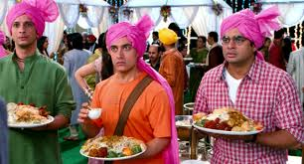
Food is served almost on all social events like marriages, parties, get-together, official meetings, etc., in the form of tea, breakfasts, banquet, dinner, etc. On all these occasions, food indirectly serves as a powerful and effective instrument for developing social rapport.
Food is the common link in a meeting, party or get-together that attracts people to come to such social gatherings. Refreshment served even at official meetings creates a relaxed atmosphere, where people can exchange their views. The menu for such get-to-gather should bring the people together, rather than divide them. Foods help to strengthen mutual friendship.

Slide 18
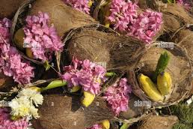
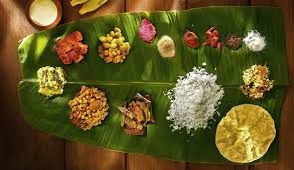
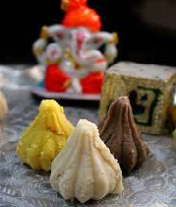
Food is the common link in a meeting, party or get-together that attracts people to come to such social gatherings. Refreshment served even at official meetings creates a relaxed atmosphere, where people can exchange their views. The menu for such get-to-gather should bring the people together, rather than divide them. Foods help to strengthen mutual friendship.
Food also has a specific significance and meaning in the religious context. Certain food items such as fruits, sweets, and coconut are offered to the deity in temples.

Slide 19
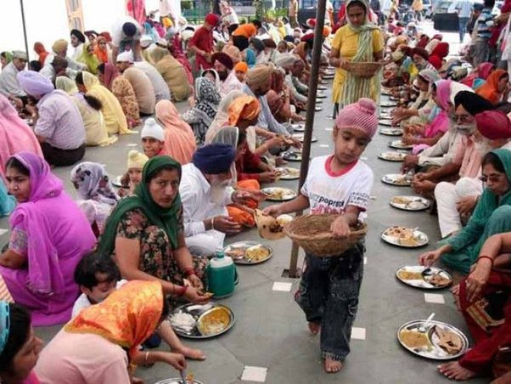
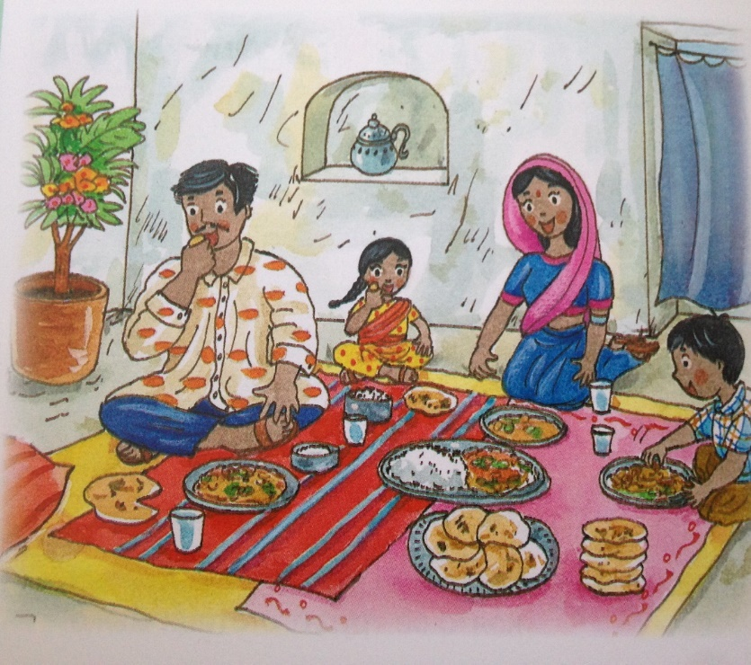
Often sweets are prepared at temples and gurudwaras and distributed to devote as a benediction or Prasad with an emotion attached to it.
(eg Langer at
Gurudwara)
The social function of foods can be seen daily - like in many of the families there is a dining culture as all the family members unite to have dinner which creates a good relationship among them.

